Slide 1
Current

Slide 2
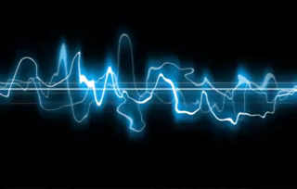
In this Smart Lesson you will learn to:
Define electric current.
Solve problems involving electric current, electric charge and time.

Slide 3
So what is electric current?
Electric current is defined as the rate of movement of electric charge carriers from one part of a conductor to another.
Electric charge carriers are usually electrons or ions.
So current is the flow of charge carriers, such as electrons.
The unit of current is Amperes (A) and electrical current is represented as (I) in formulae.
For example V=I×R, where V is voltage, I is current and R is resistance.

Slide 4
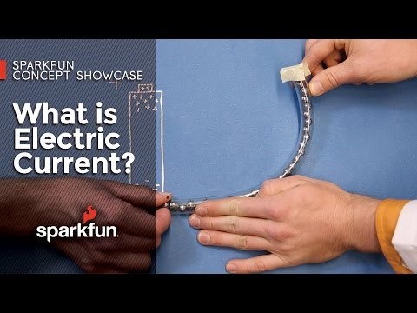

Slide 5
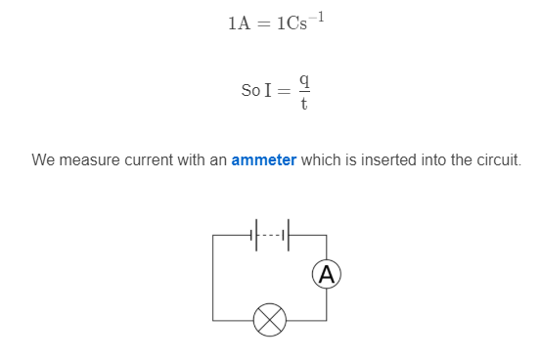
Movement of charge can be quantified as a flow of current.
Current, I, is the amount of charge that passes a point (q) and how long it takes those charges to pass that point (t).
Current is measured in Amperes (A). One ampere equals one coulomb of charge passing a point in one second.

Slide 6
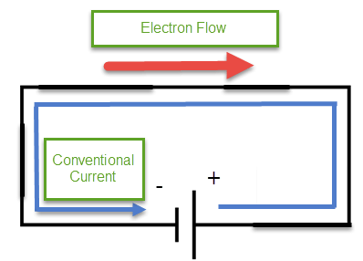
Up to this point, we have discussed current as the flow of electrons because it is their movement that actually creates a current in a wire.
However the original convention of current was that electricity was the flow of positive charge, this is called conventional current. This is the prevailing way that circuits continue to be taught and discussed, despite that positive charges cannot move in circuits.
Under conventional current, circuit potential goes from highest at the positive battery terminal to lowest at the negative terminal.
Current flows from positive to negative, against the flow of electrons.

Slide 7
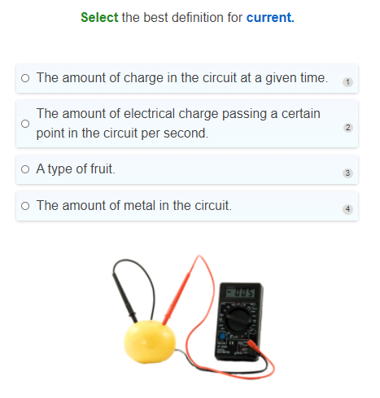

Slide 8
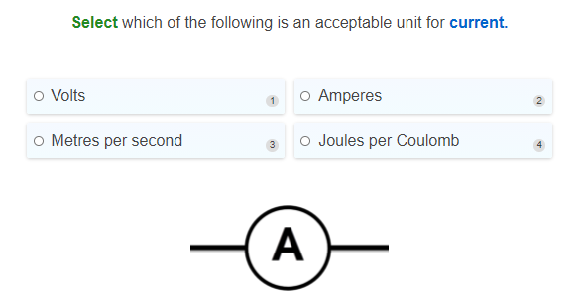

Slide 9
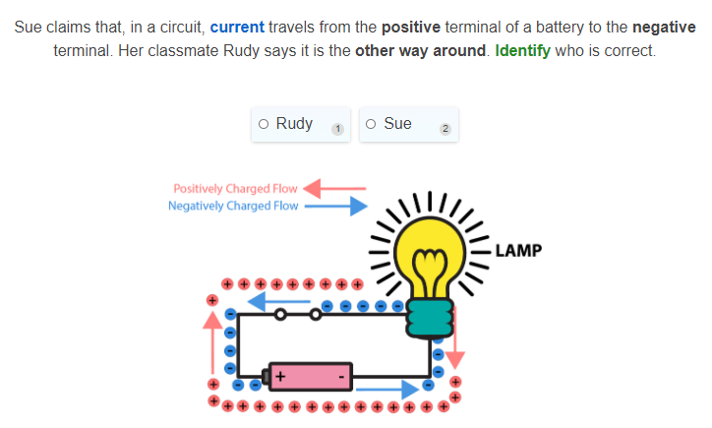

Slide 10
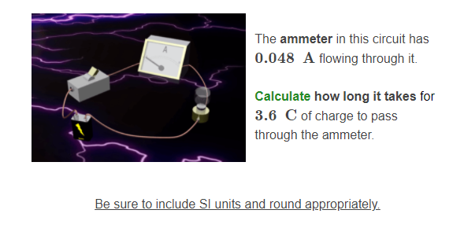

Slide 11
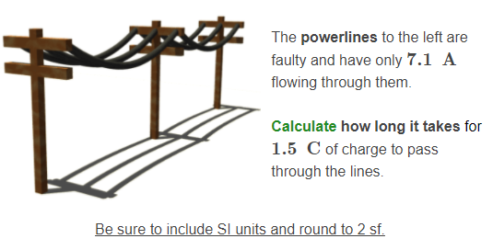

Slide 12
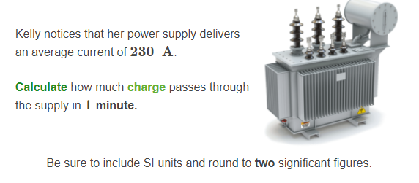

Slide 13


When you flick a light switch, it appears to our eyes that the light comes on immediately.
This is not entirely the case.
When the switch is flicked it closes a circuit and the power source sets up a potential difference between each end of the circuit. The voltage causes a current to flow from the positive terminal of the power supply.

Slide 14
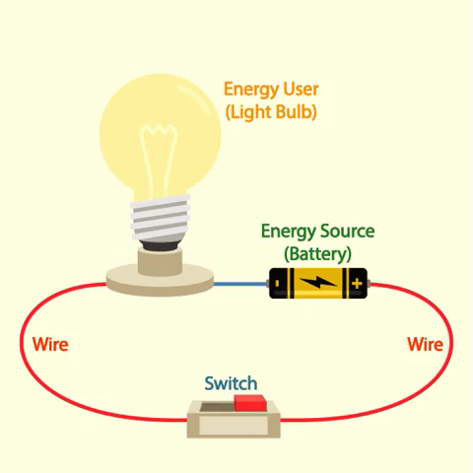
Before an electrical effect is established, there is no current and electrons move randomly in all directions with no net movement.
Closing the circuit applies a voltage to the electrons and establishes the electrical effect. A general direction is imposed on the electrons, moving them from negative to positive terminals.
While the electrons have a net direction towards the positive terminal, they will move randomly in all directions as they travel there.
This makes electron travel through the circuit surprisingly slow, despite the fact that the effect establishes immediately.

Slide 15
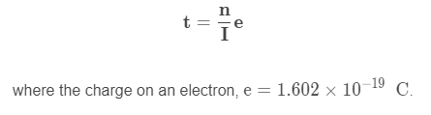
It is possible to calculate how long it takes an electron to move along a particular section of wire.
If you are provided with the number of electrons in the wire (n) and the current in the wire (I), you can calculate the time taken for an electron to move through it using the below equation:

Slide 16
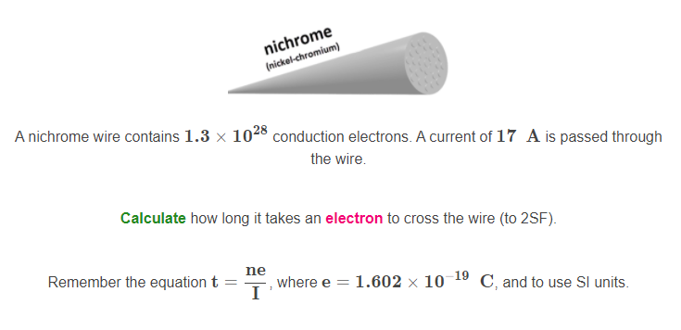

Slide 17
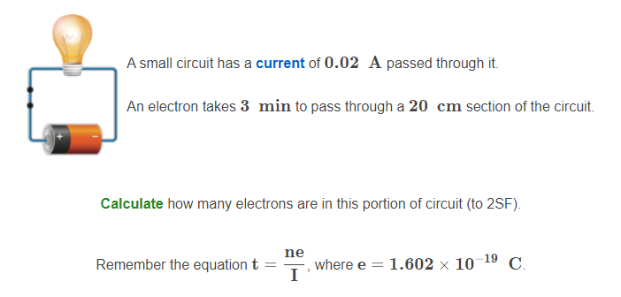

Slide 18
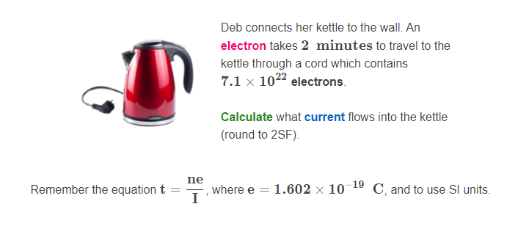

Slide 19
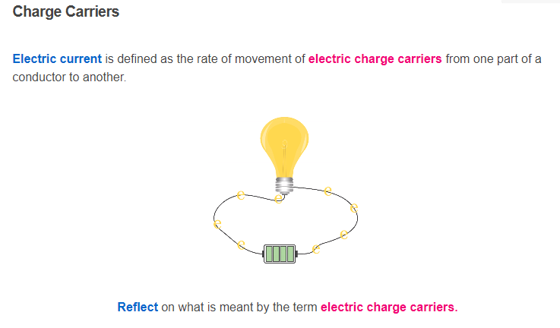

Slide 20
